Slide 1


Neighborhood Pocket
Neighborhood watch for the 21st Century

Slide 2
Neighborhood Pocket
Developers
Jose Perea
Zachary Anderson
Keith Haizlett

Slide 3
Neighborhood Pocket
The Problem
Shady happenings
Police spread
Lack of documentation

Slide 4
Neighborhood Pocket
Vision
The goal of Neighborhood Pocket is to empower the public to quickly and anonymously report suspicious activity

Slide 5
Neighborhood Pocket
The solution
See something? Say something!
Crowdsourcing of data

Slide 6
Neighborhood Pocket
Approach
Classic problem – modern solution
Instant sharing
Intuitive view

Slide 7
Neighborhood Pocket
Youthful insight
Ease
Anonymity
Moderation

Slide 8
Neighborhood Pocket
Carefully Coded
Java
Processing

Slide 9
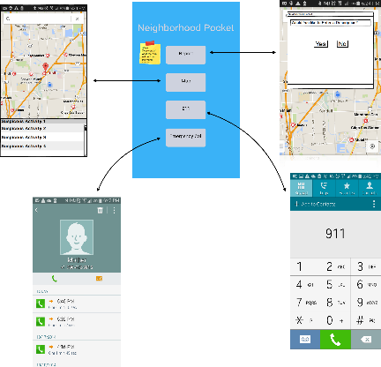
Neighborhood Pocket

Slide 10
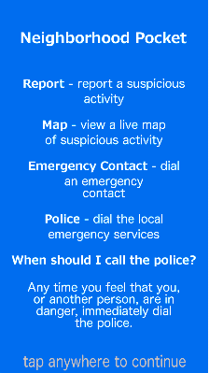
Neighborhood Pocket
Simple
Brief

Slide 11
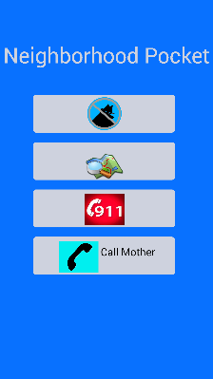
Neighborhood Pocket
Intuitive
Functional

Slide 12
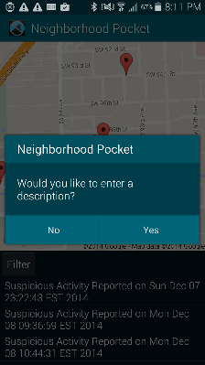
Neighborhood Pocket
Anonymous
Instant
Expandable

Slide 13
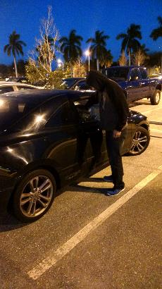
Neighborhood Pocket
Text description
Image capable

Slide 14
Neighborhood Pocket
Build
Standardized
Documented
Extensible

Slide 15
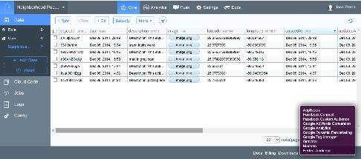
Neighborhood Pocket
Data Handling
via parse.com

Slide 16
Neighborhood Pocket
Future Development
Police moderation
Web viewing
iOS development

